Slide 1
Power BI Training Basic Admin in a Day
January 2022 release
© 2022 Microsoft. All rights reserved.

Slide 2
Course Agenda
 | Subject | Suggested time
Basic Modules
 | Introduction to Power BI | 15 minutes
 | Understanding the Power BI Administrator Roles | 15 minutes
 | Providing Governance in a Power BI Environment | 15 minutes
 | Establishing a Power BI Environment | 30 minutes
 | Facilitating Collaboration and Sharing | 30 minutes
 | Usage Monitoring and Auditing | 30 minutes
 | Lunch Break | 1 hour
Advanced Modules
 | Provisioning Premium Capacity | 45 minutes
 | Establishing a Data Access Infrastructure | 30 minutes
 | Gateway | 30 minutes
 | Broadening the Reach of Power BI | 30 minutes
 | Automating Power BI Admin | 30 minutes
© 2022 Microsoft All rights reserved.

Slide 3
Power BI Admin in a Day
At the end of the training, please fill our survey
https://aka.ms/PBIAdminIADSurvey
It helps us maintain and improve the training
© 2022 Microsoft. All rights reserved.

Slide 4
Power BI Admin in a Day
Introduction to Power BI
© 2022 Microsoft. All rights reserved.

Slide 5
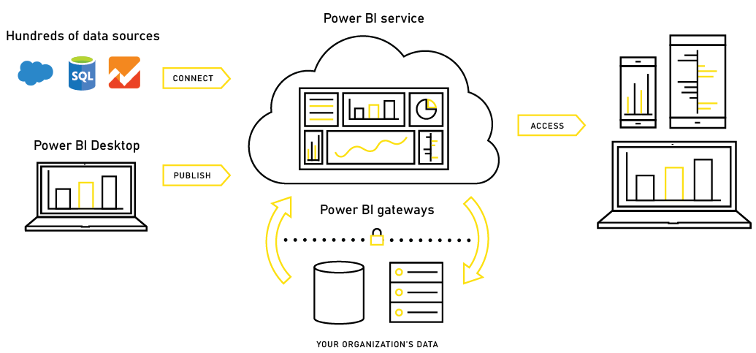
Power BI – Experience Your Data
Any data, any way, anywhere
© 2022 Microsoft. All rights reserved.

Slide 6
Tools
Power BI Desktop
Query Editor
Data Modeling
Visualization
Power BI Service
Datasets
Reports
Dashboards
Workspaces (V1 and V2)
Apps
Dataflows
© 2022 Microsoft. All rights reserved.

Slide 7
Power BI Admin in a Day
Demo
Introduction to Power BI
© 2022 Microsoft. All rights reserved.

Slide 8
Power BI Admin in a Day
Understanding the Power BI Administrator Role
© 2022 Microsoft. All rights reserved.

Slide 9

Are you a Steward or a Captain
Self Service
Enterprise
Power BI steward
Monitors the users in a Power BI environment.
Establishes processes, policies, and guidelines to help users take the right actions in compliance with local and international laws as well as organizational policies.
Moves the organization towards a culture that views data as a competitive asset.
 | Power BI captain
 | Responsible for the safe and efficient operation of a Power BI environment.
 | Limits what users can do in a Power BI environment to ensures compliance with local and international laws as well as organizational policies.
 | Cares about all resources/solutions in the Power BI environment. It doesn’t matter what resources/solutions are shared with the admin’s user account.
© 2022 Microsoft. All rights reserved.

Slide 10
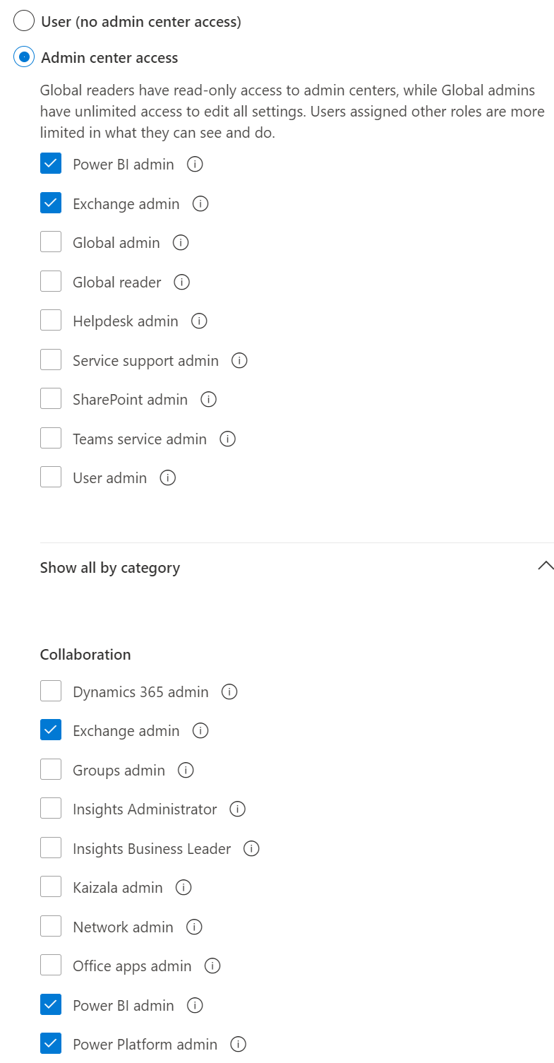
Power BI Administrator Role
No admin perms needed to register Apps!
Administrator type | Scope
Office 365 Global Administrator | Office 365
Office 365 Billing Administrator | Office 365
Power BI Service Administrator | Power BI
Power BI Capacity Administrator | A single capacity (Premium or Azure)
Power BI App Workspace Administrator | A single app workspace
Power Platform Service Administrator | Power Platform
© 2022 Microsoft. All rights reserved.

Slide 11
Typical Admin Tasks
Global Admin
Assigning licenses
Audit logging
Power Platform Administrator
Manage Gateways (coming soon)
Power BI Administrator
Controlling access
Controlling Power BI tenant features
Manage Gateways
Activity Log
Monitoring usage
© 2022 Microsoft. All rights reserved.

Slide 12
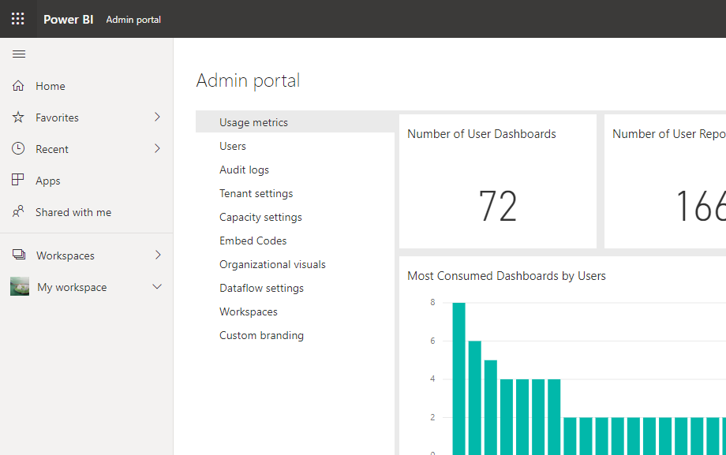
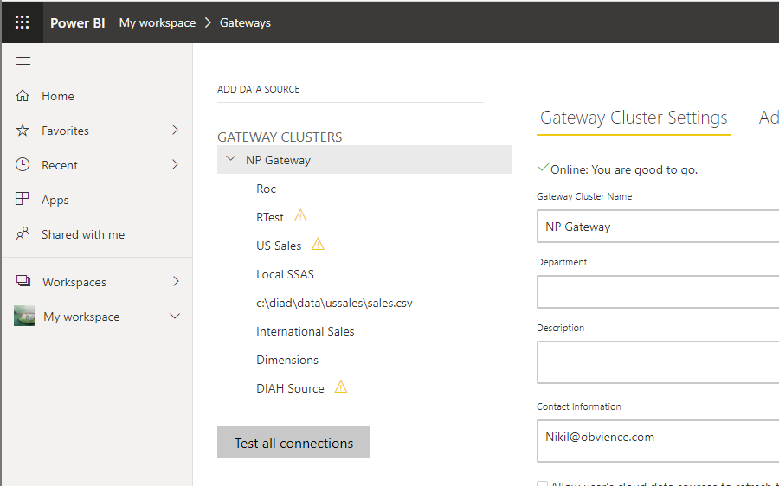
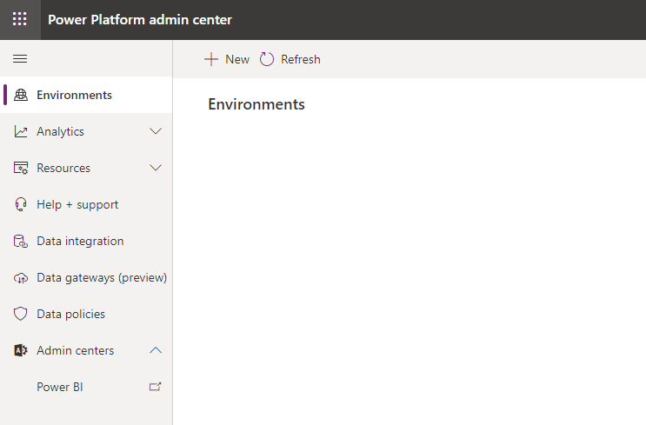
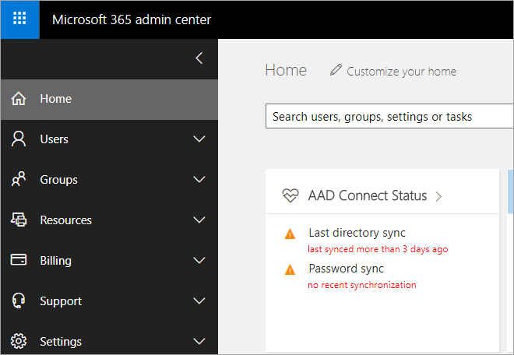
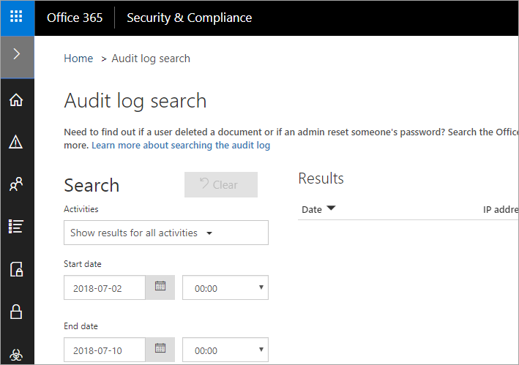
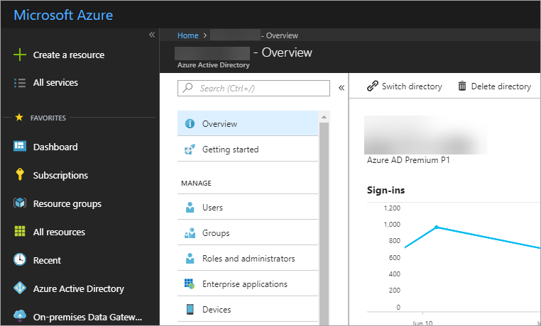
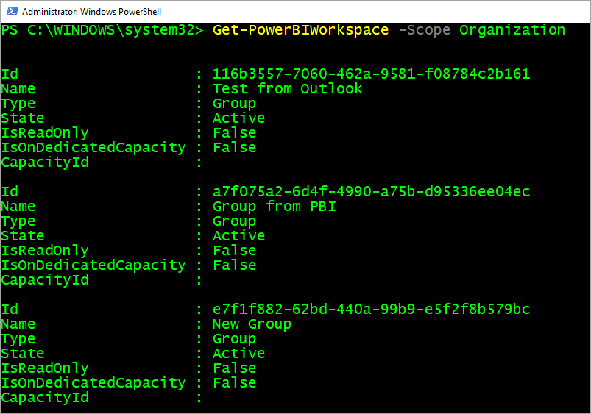
Typical Admin Tools
Power BI Admin Portal
Power BI Gateway Management
Power Platform Admin Center
Microsoft 365 Admin Center
Security & Compliance Center
Azure Active Directory Portal
PowerShell
REST APIs
© 2022 Microsoft. All rights reserved.

Slide 13
Power BI Admin in a Day
Knowledge Check 1 – Understanding the Power BI Admin role​
https://aka.ms/AdIADReview1​
© 2022 Microsoft. All rights reserved.

Slide 14
Power BI Admin in a Day
Providing Governance in a Power BI Environment
© 2022 Microsoft. All rights reserved.

Slide 15
Role of Administration and Governance
IT / BI Teams
Business Users
Data Engineering
Enterprise Reporting
Requirements Gathering
Ad hoc analysis and reporting
Collaboration
Central IT
Training and Education
Data Governance
Enabling Business Process & Access control
Procurement & Administration
© 2022 Microsoft. All rights reserved.

Slide 16
Elements of Data Governance
Visibility
Control
Compliance
Understand system state and activity
Enforce policies for use of the system
Configure the system to achieve compliance requirements
© 2022 Microsoft. All rights reserved.

Slide 17
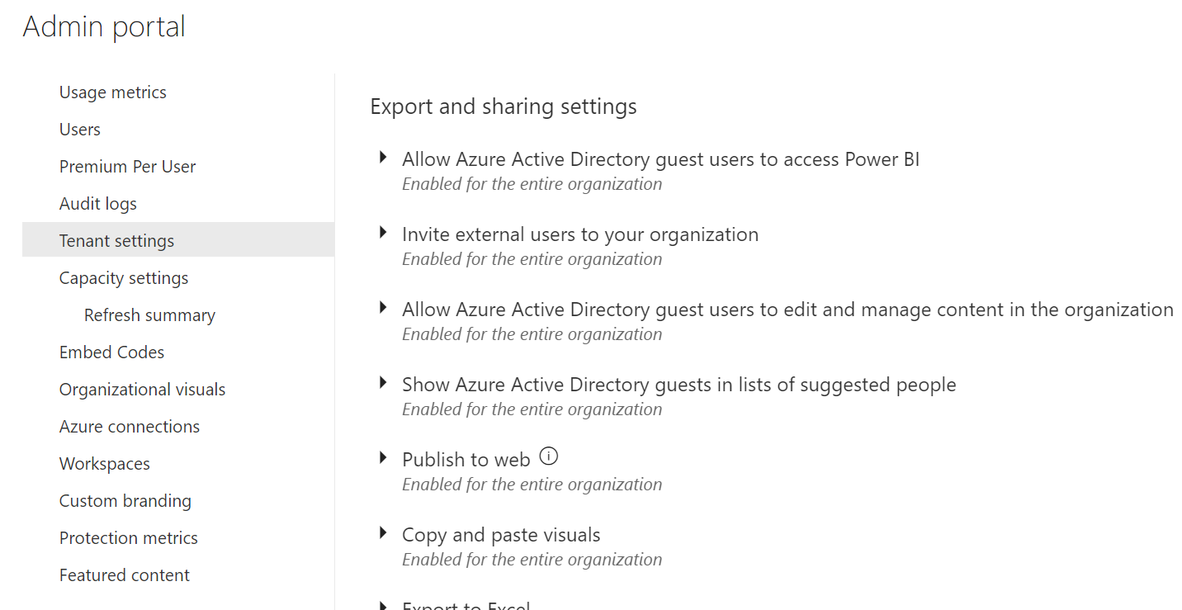
Configure Tenant Settings
Part of Power BI Admin Portal
Global Admin or Power BI Service Administrator or Power Platform Service Admin
Provides for granular settings
Controls tenant level operations
Example: You can disable Publish to Web!
© 2022 Microsoft. All rights reserved.

Slide 18
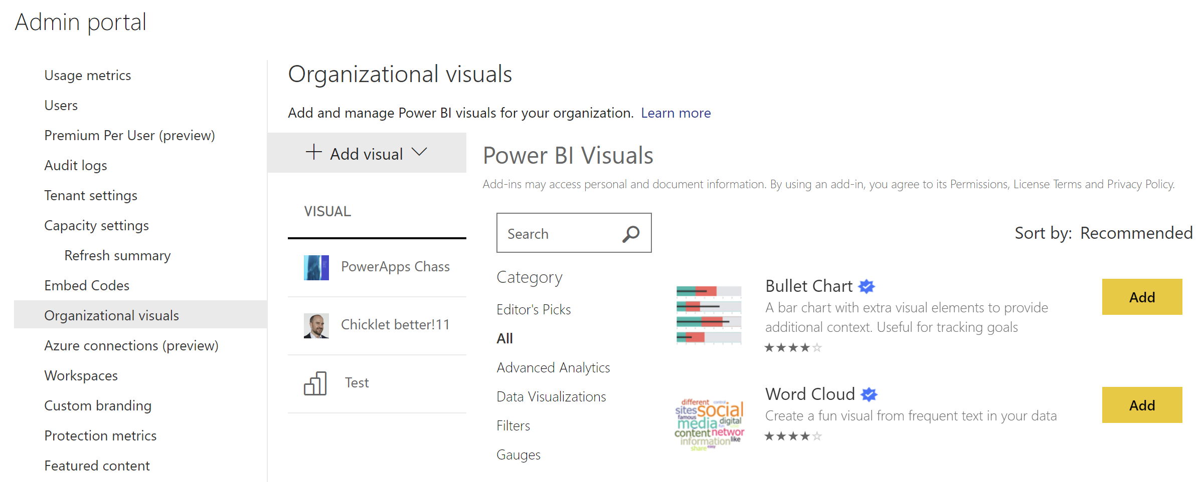
Deploying Organizational Visuals
Managed in Power BI Admin Portal
Establish approval process for usage of custom visuals
Used to distribute internal custom visuals to organization
Can also list blessed custom visuals
© 2022 Microsoft. All rights reserved.

Slide 19
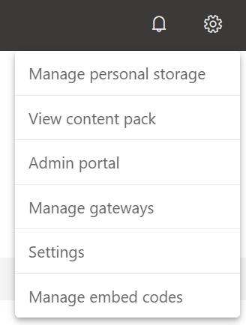
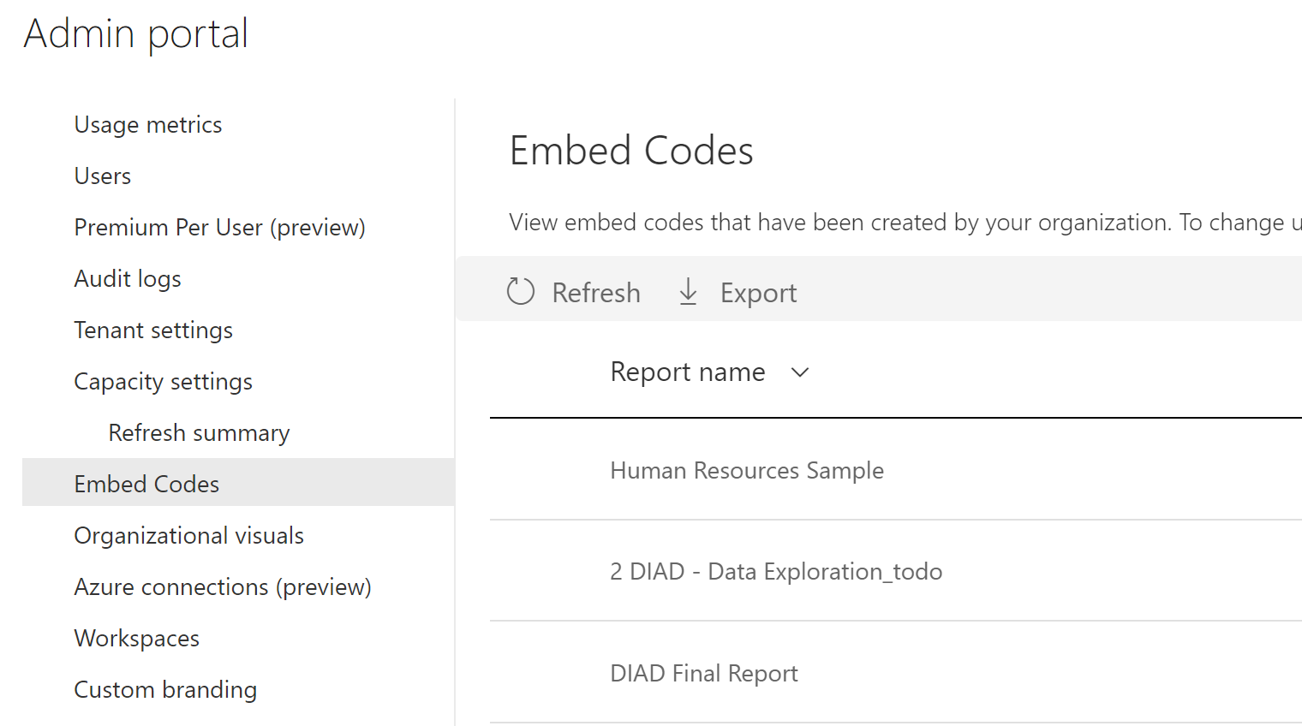
Managing Embed Code
Embed codes generated from Publish to Web
Users can manage their own embed codes
Admins can control all embed codes in tenant through Admin Portal
© 2022 Microsoft. All rights reserved.

Slide 20
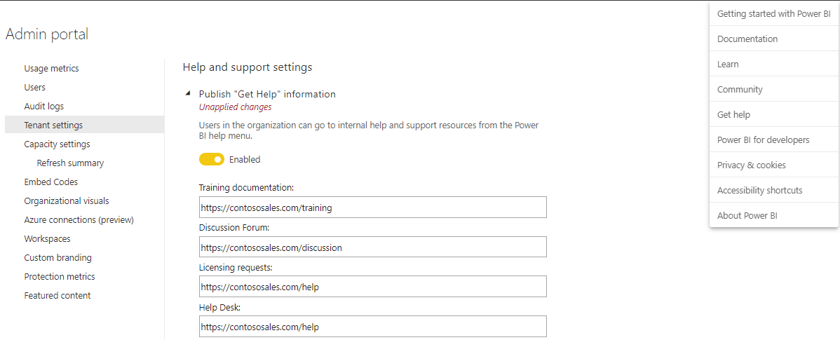
Help and Support Settings
Power BI customizes help and support links in help menu to point your users to specific organizational content
In Admin Portal ->Tenant settings -> Publish “Get Help” information toggle the Disabled button to Enabled, and then provide appropriate URLs to your company’s sites for training documentation, discussion forums, and help desk
© 2022 Microsoft. All rights reserved.

Slide 21
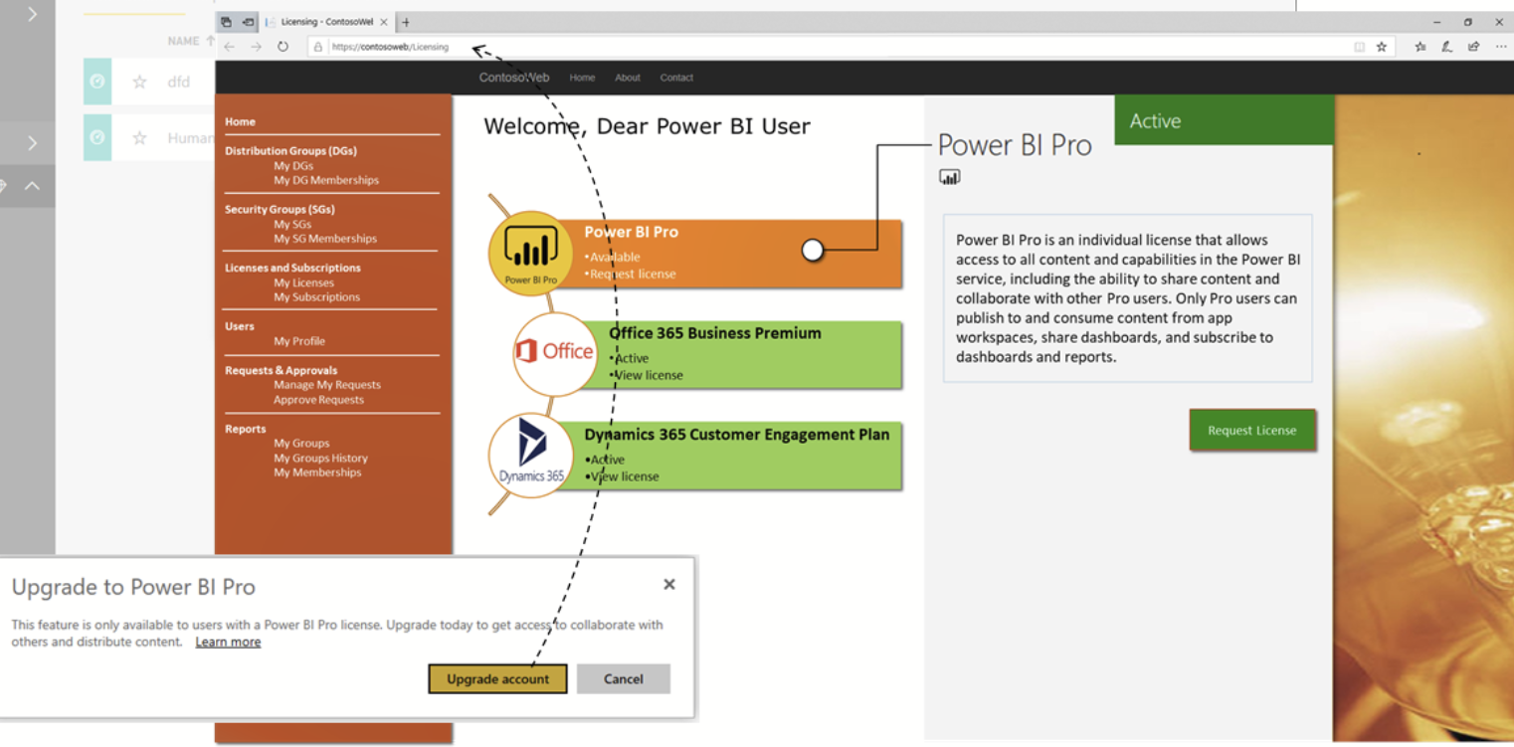
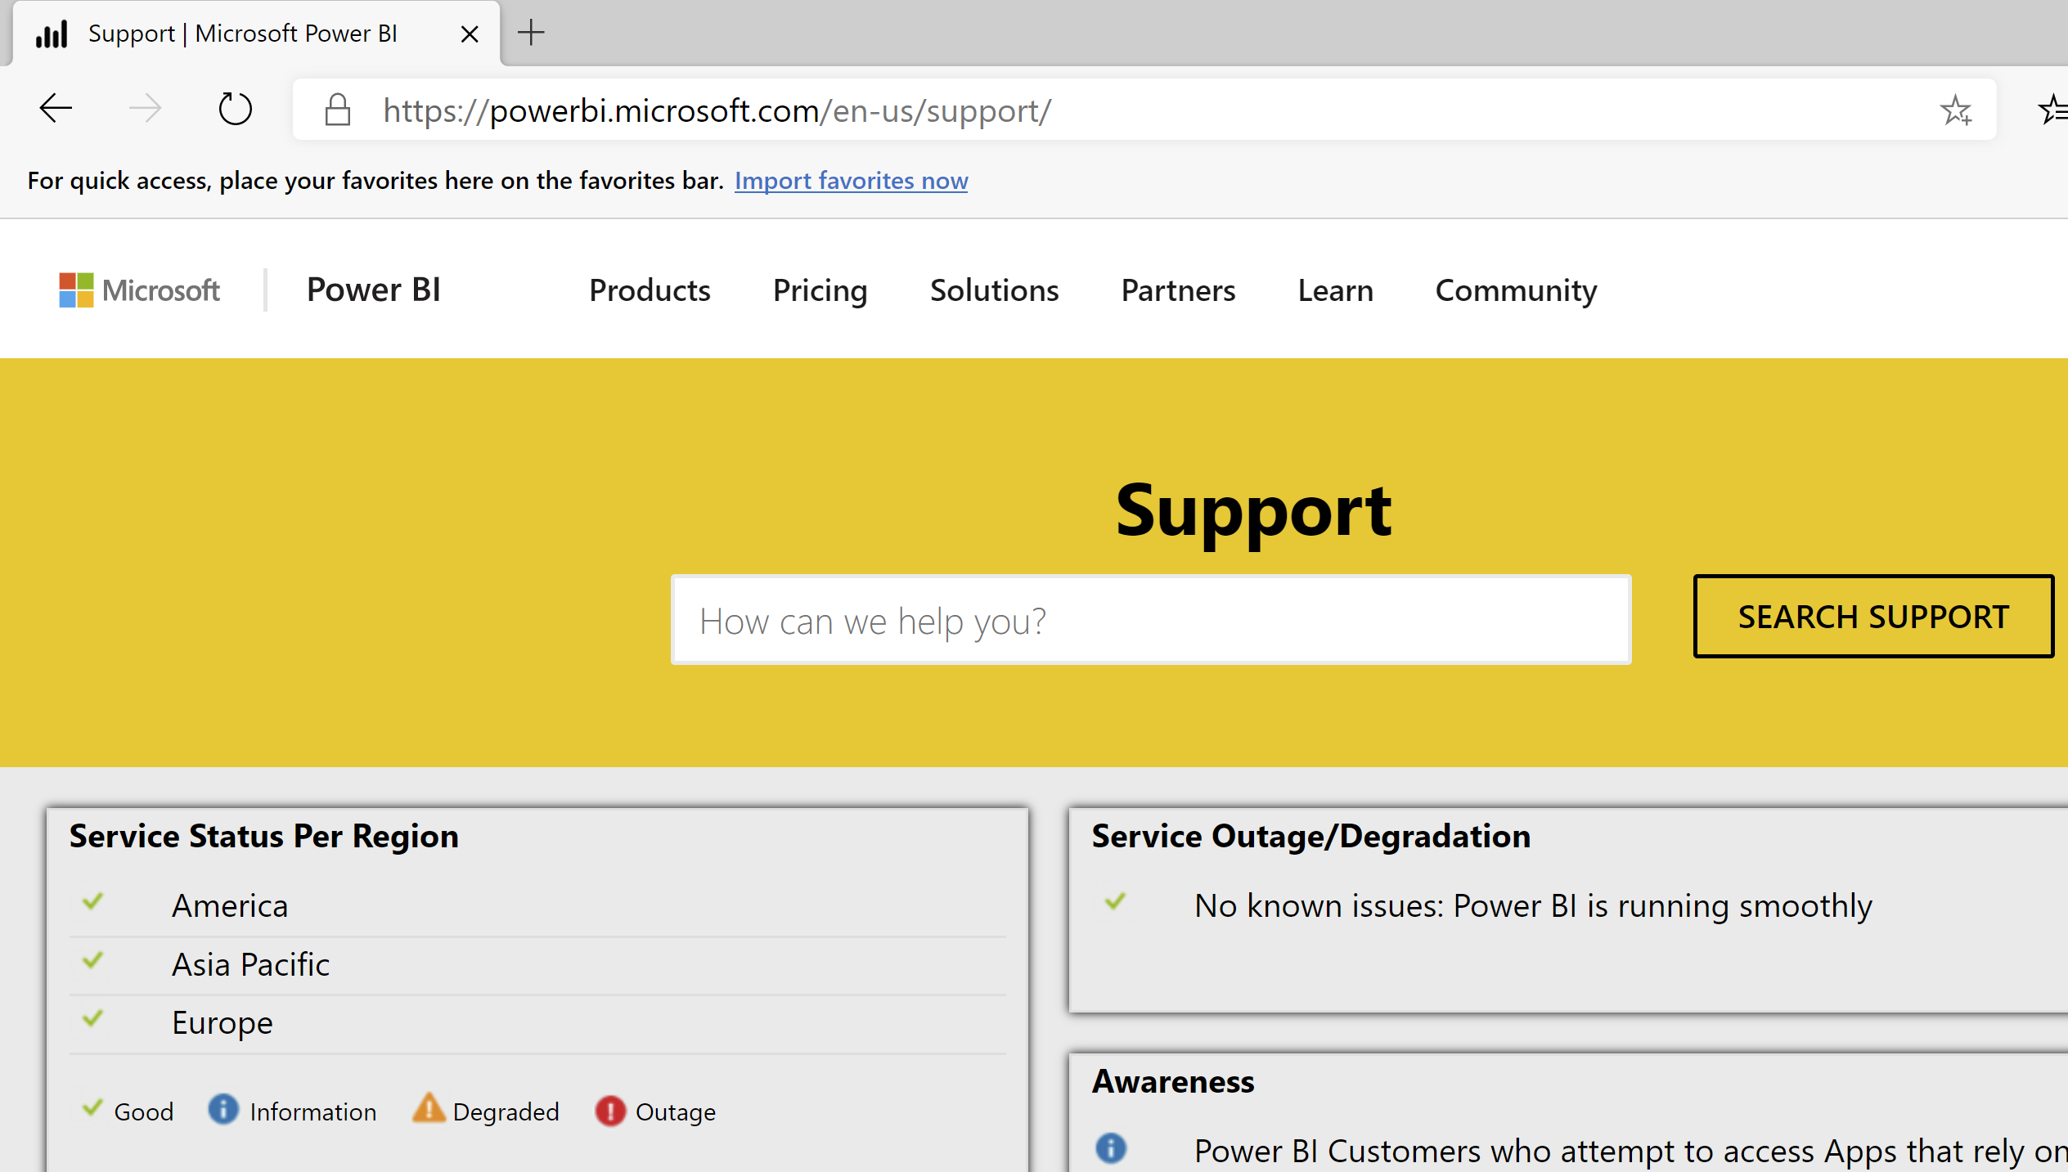
Help and Support Settings
Customize the link to acquire a Power BI license
Customize the target URL of the Upgrade account button
Guides users through the process defined in your organization
For Power BI Support and status use https://support.powerbi.com/
© 2022 Microsoft. All rights reserved.

Slide 22
Power BI Admin in a Day
Establishing a Power BI Environment
© 2022 Microsoft. All rights reserved.

Slide 23


The Tenant/Your Organization
Office 365 Bubble
Azure Active Directory is the foundation
Shared accounts and groups
Includes subscriptions and licenses
Azure Active
Directory
Office 365
Power BI
© 2022 Microsoft. All rights reserved.

Slide 24
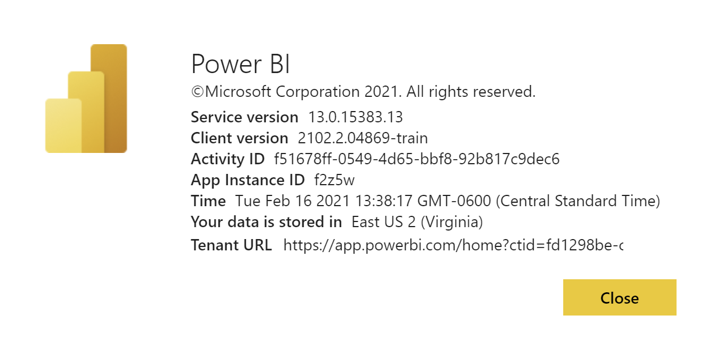
Choosing Your Data Center
Power BI Tenant created in Azure Data Center
Not possible to select Power BI location directly (more on this later)
Based on Office 365 country or Azure Active Directory data center
Think about other Azure services! Could result in egress charges!
© 2022 Microsoft. All rights reserved.

Slide 25
User Accounts vs Guest Accounts
User Accounts
Exist within the organization
Can create and consume content based on access and license
Mobile app can be used
Guest Accounts
External to the organization
Part of Azure AD B2B & B2C
Can consume, edit and manage content
Must have direct URL to shared content
Can be consumer accounts (@outlook.com, @Hotmail.com, @gmail.com)
Mobile app can be used
© 2022 Microsoft. All rights reserved.

Slide 26
Licensing
Power BI Desktop
Power BI Pro
Power BI Premium
App download
Licensed by user
Licensed by user
Licensed by capacity
Free report authoring and ad-hoc data exploration
Quick, easy-to-use self-service analytics for users requiring collaboration, dashboard sharing, ad hoc analysis, and report publishing
All the capabilities of Power BI Pro with Premium per user with Premium feature performance
An add-on to Power BI Pro for projects requiring large scale data, demanding performance, and the ability to distribute content without requiring per user licensing
© 2022 Microsoft. All rights reserved.

Slide 27
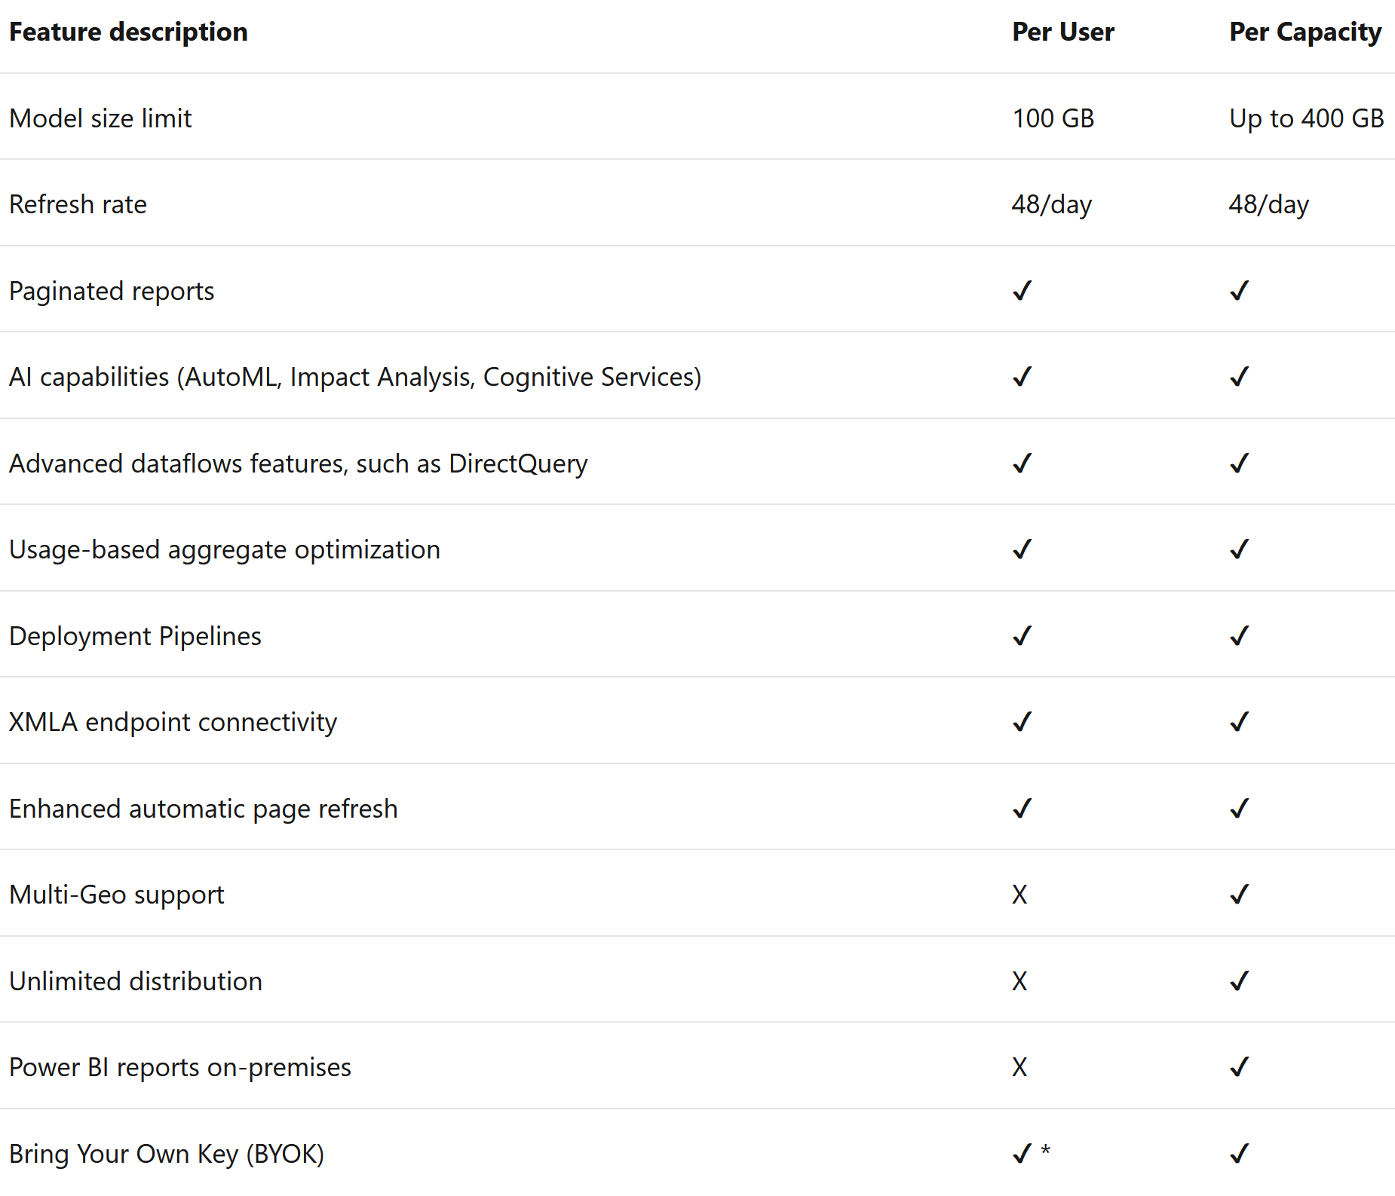
Power BI Premium Feature Comparison
© 2022 Microsoft. All rights reserved.

Slide 28
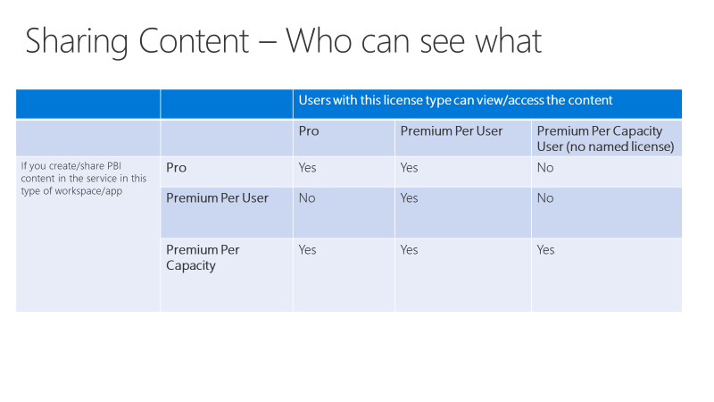
Power BI Premium per User (PPU)
New way to license premium features on a per user basis
Includes capabilities of Pro
No dependency on authors publishing to Premium
PPU can be turned on for any workspace
User must have PPU license to access Premium Per user workspace
© 2022 Microsoft. All rights reserved.

Slide 29
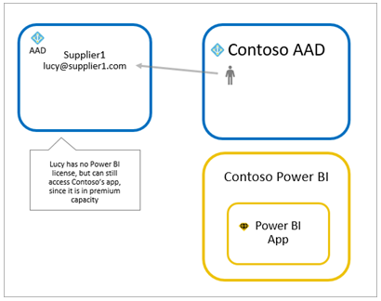
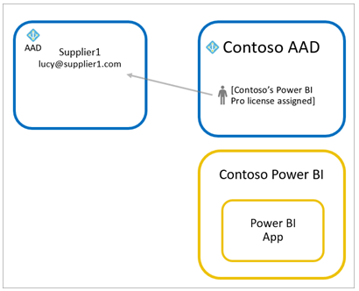
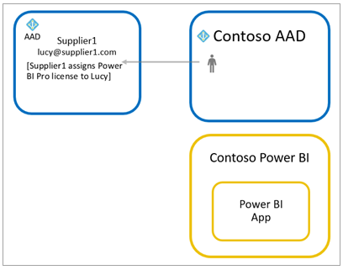
Guest Licensing
Use Power BI Premium
Power BI Pro to guest user
Bring Own Power BI Pro
© 2022 Microsoft. All rights reserved.

Slide 30
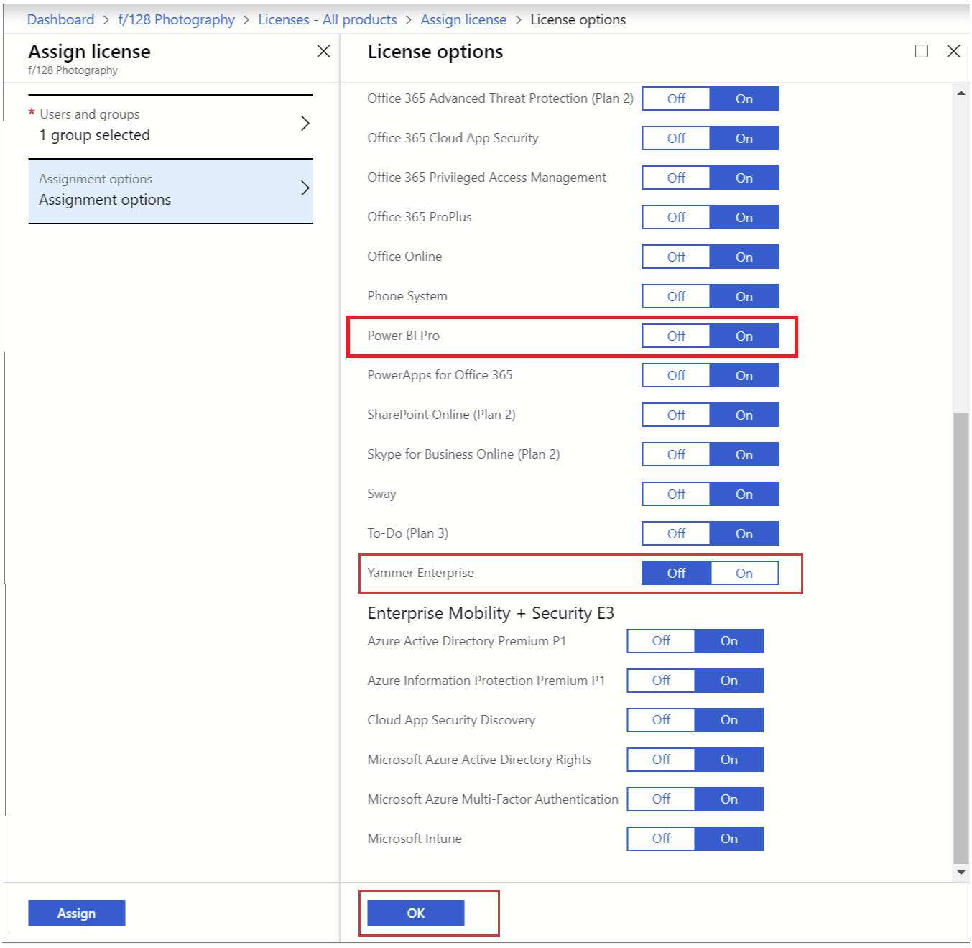
License Assignment
Power BI (Free) assigned with viral sign-up
Assigned via O365 Admin Center, Azure Portal or PowerShell
Group based licensing through Azure Active Directory
© 2022 Microsoft. All rights reserved.

Slide 31
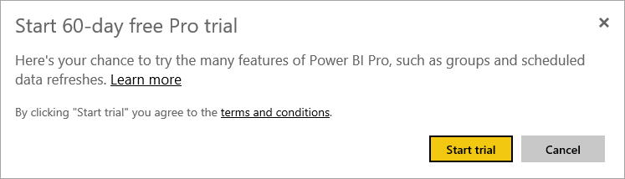

Understanding Pro Trials
Two Pro trials
60 day In Service trial
30-day Power BI Pro trial within O365 Admin Center (25 Licenses)
In service trial is an individual opt-in scenario
Admins can block or revoke
In service trial may opt in during user sign up if user doesn’t exist
When trial expires, user is reverted to a non-Pro experience
© 2022 Microsoft. All rights reserved.

Slide 32
Premium Per User Trials
Two Premium Per User trials
In Service trial
Premium Per User trial within O365 Admin Center
Any user can access In Service trial
Trial experiences through O365 can be enabled through the portal
© 2022 Microsoft. All rights reserved.

Slide 33
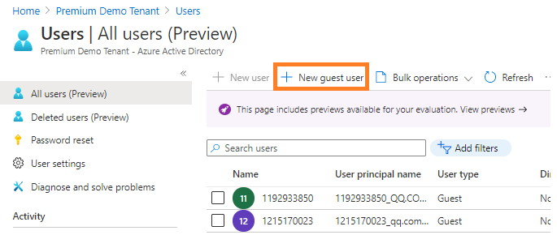
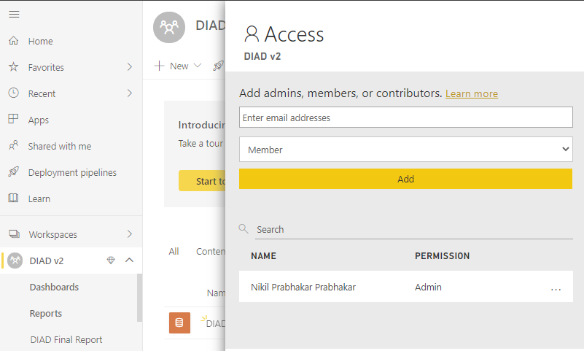
Configuring B2B Trust/Enabling & Monitoring
Power BI integrates with Azure Active Directory Business to Business to allow secure distribution of Power BI content to guest's users, while still maintain control and governing access
Planned invites for large number of users using PowerShell
Add the user in Azure AD as a new guest user
Edit invitation to be sent
Or
Add user directly to the Power BI workspace
© 2022 Microsoft. All rights reserved.

Slide 34
Power BI Admin in a Day
Demo
Establishing Roles & Licensing
© 2022 Microsoft. All rights reserved.

Slide 35
Power BI Admin in a Day
Knowledge Check 2 – Establishing Roles and Licensing ​
https://aka.ms/AdIADReview2​
© 2022 Microsoft. All rights reserved.

Slide 36
Power BI Admin in a Day
Facilitating Collaboration and Sharing
© 2022 Microsoft. All rights reserved.

Slide 37
My Workspace vs Workspaces vs Apps
My Workspace
Personal sandbox for individual user
Every user has this
IF IN DOUBT DO NOT USE
Workspace
Workspace used for collaboration
Can be specific to a team or subject area
When in doubt, use this!
Pro feature
Apps
Based on the workspace, packaged content and publishes/shares
Used for broad distribution of consumable content (View only)
May require Pro license if not backed with Premium
Apps can be pushed to groups
https://powerbi.microsoft.com/en-us/blog/duplicating-workspaces-by-using-power-bi-cmdlets/
© 2022 Microsoft. All rights reserved.

Slide 38
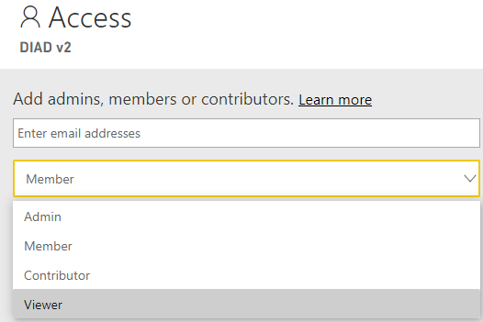
Workspaces Evolved
Old Workspaces​
Bound to O365 Modern Group (Shared with Teams, SharePoint, OneDrive…)​
Only individuals could be listed​
Can list Admins and Members (All members have edit or read rights)​ ​
Improved Workspaces​
Not bound to O365 Modern Group​
Can include individuals and security groups​​
© 2022 Microsoft. All rights reserved.

Slide 39
Improved Workspace Experience
Create Workspace
Does not create an Office 365 Group
Workspace is only available in Power BI
Group Membership
Allows all kinds of user groups
Security, Email enabled security, Distribution lists, Office 365 groups, individual users
New Workspace roles
Migration
Staged migration with opt-in migration at GA
Required migration post GA
No support for content packs
Power BI Admins
Power BI Admin controls who can create workspaces
APIs/Rest for managing workspaces (e.g. enumeration, recovering, assigning owners)
© 2022 Microsoft. All rights reserved.

Slide 40
Impact to Power BI Users
Side by side: Workspaces v1 and v2
Will live side by side during preview and before migration completes
Different permissions possible on different kinds of workspaces
Setting WSv2 permissions won’t change O365 Groups membership
Migration will be required
Manual migration possible during preview (recreate)
Opt-in migration will be available at GA
Post GA* mandatory migration * Mandatory migration will happen as soon as Microsoft is working to ensure this change will not break many customers current set up.
© 2022 Microsoft. All rights reserved.

Slide 41
Permissions in Workspaces v2
Admin
Contributor
Can change and delete workspaces
Add Admins
Everything a Member can do
Add/edit/delete content within the workspace
Everything a Viewer can do
Member
Viewer
“Reshare” – add new users to be Members or lower permissions
Publish and update Apps
Everything a Contributor can do
View content within the workspace
Replaces read-only workspaces
© 2022 Microsoft. All rights reserved.

Slide 42
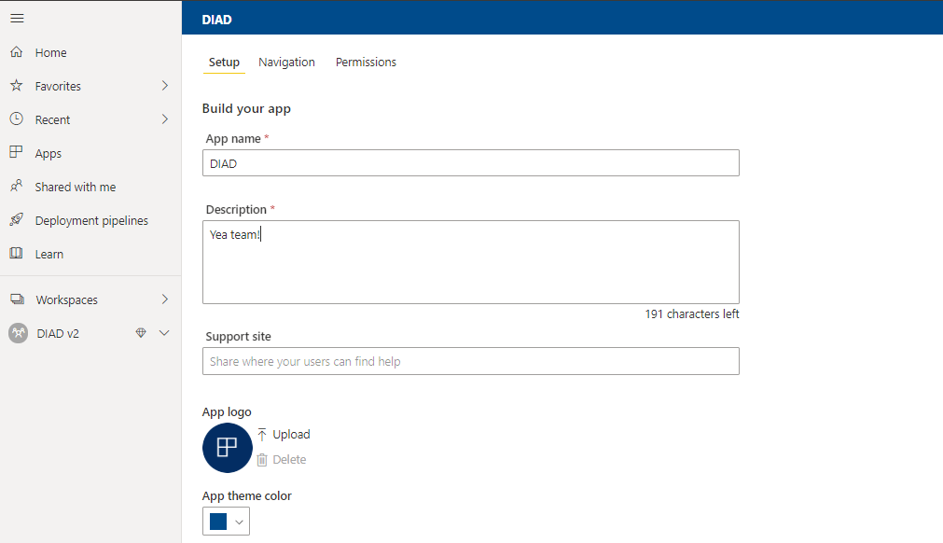
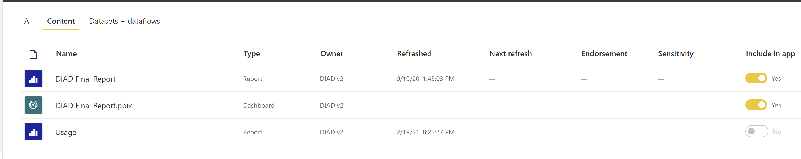
Power BI Apps
© 2022 Microsoft. All rights reserved.

Slide 43
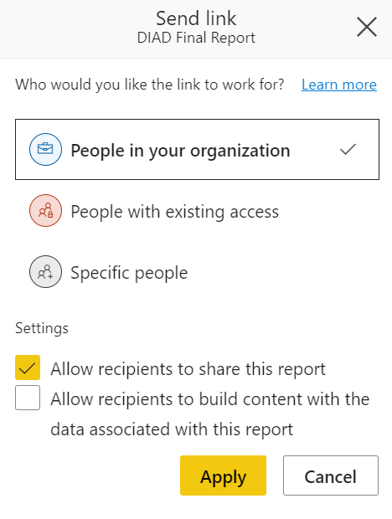
Sharing
Can share Reports and Dashboards
Share can be to external users by way of Azure AD B2B and B2C
Sharing to external users can be disabled in Tenant settings
Access can be revoked by content owner
© 2022 Microsoft. All rights reserved.

Slide 44
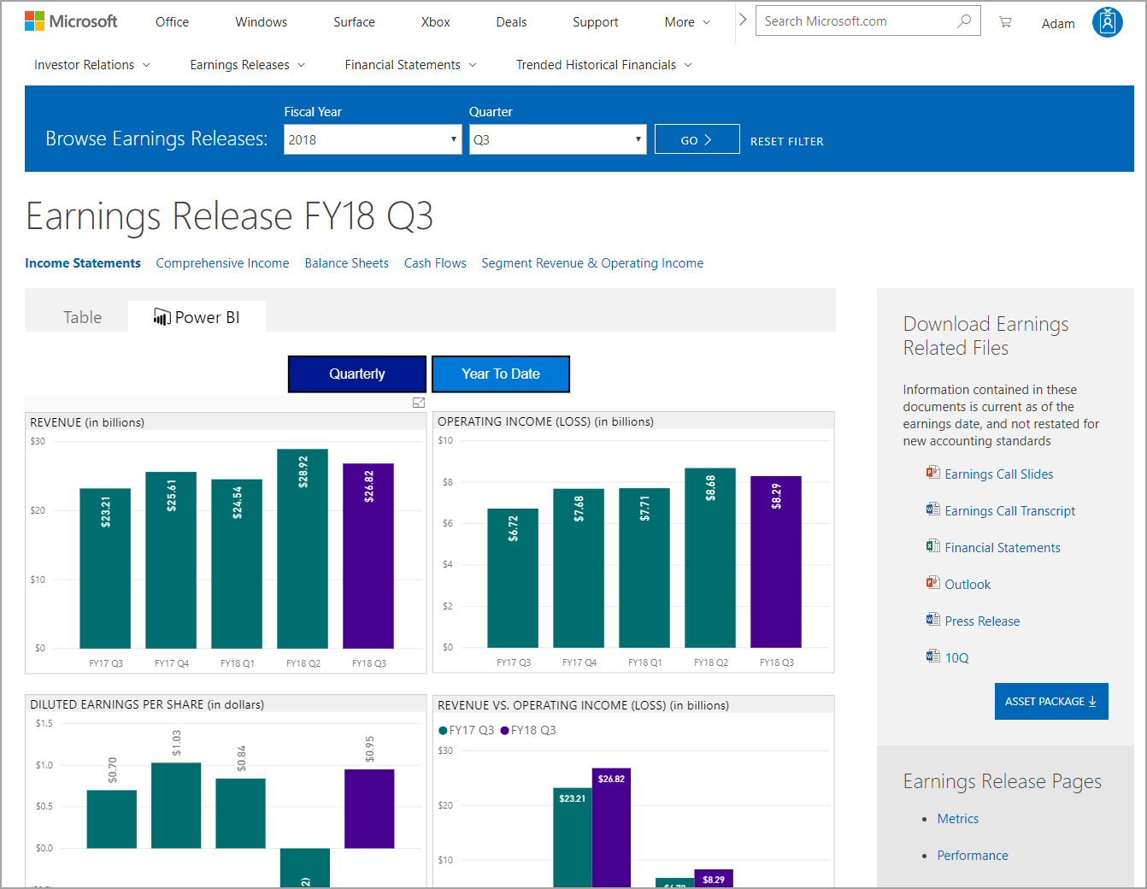
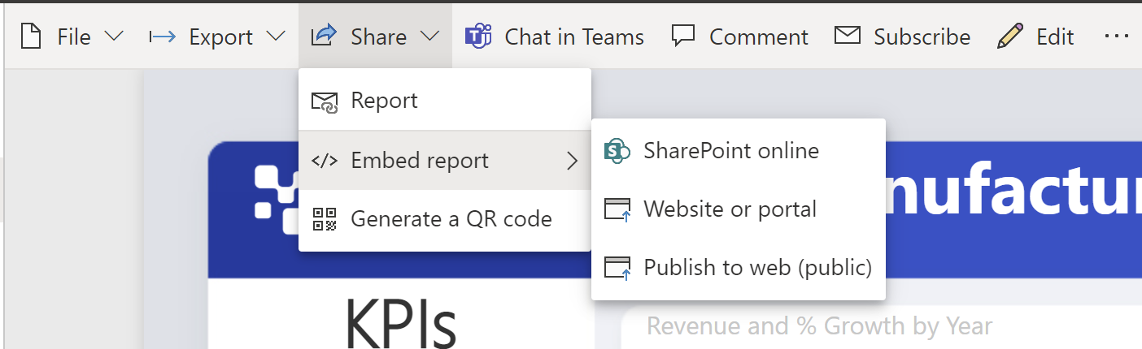
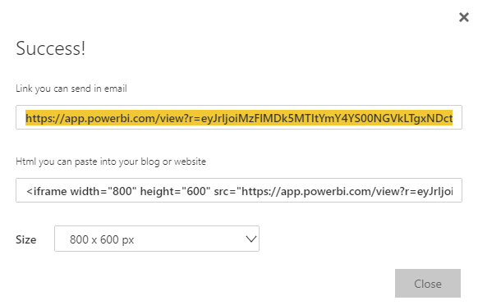
Publish to Web
Covered in more depth later
Generates Embed code
No authentication required (not secure!!!)
Great for Public Relations!
© 2022 Microsoft. All rights reserved.

Slide 45
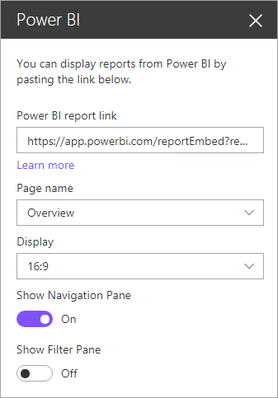
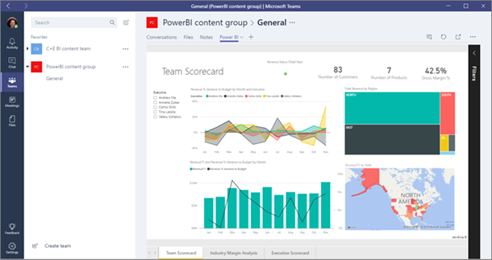
Embedding and Linking in Portals
Embedding via SPO Web Part or Teams integration
URLs to shared content can be listed in emails or on web sites
Will be reviewed in detail later today
© 2022 Microsoft. All rights reserved.

Slide 46
Data Sensitivity Labels
Power BI can integrate with Microsoft Information Protection and Microsoft Cloud App Security to provide greater control and visibility over sensitive data in Power BI
Certain users/security groups can classify and apply sensitivity labels to their Power BI dashboards, reports, datasets, and dataflows
All members of the organization can see those labels
Data sensitivity labels promote data protection by making Power BI authors and consumers aware of data sensitivity
Power BI data that has a data sensitivity label is exported to an Excel, PowerPoint, or PDF file and its data sensitivity label goes with it
© 2022 Microsoft. All rights reserved.

Slide 47
Data Privacy
Privacy levels specify an isolation level that defines the degree that one data source will be isolated from other data sources
Setting | Description | Example Data Sources
Private data source | A Private data source contains sensitive or confidential information, and the visibility of the data source may be restricted to authorized users. Data from a Private data source will not be folded to other sources (not even to other Private sources) | Facebook data, a text file containing stock awards, or a workbook containing employee review information
Organizational data source | An Organizational data source limits the visibility of a data source to a trusted group of people. Data from an Organizational data source will not be folded to Public data sources, but may be folded to other Organizational data sources, as well as to Private data sources | A Microsoft Word document on an intranet SharePoint site with permissions enabled for a trusted group
Public data source | A Public data source gives everyone visibility to the data contained in the data source. Only files, internet data sources, or workbook data can be marked Public. Data from a Public data source may be freely folded to other sources | Free data from the Microsoft Azure Marketplace, data from a Wikipedia page, or a local file containing data copied from a public web page
© 2022 Microsoft. All rights reserved.

Slide 48
Power BI Admin in a Day
Demo
Collaboration and Sharing
© 2022 Microsoft. All rights reserved.

Slide 49
Power BI Admin in a Day
Knowledge Check 3 - Collaboration and Sharing ​
https://aka.ms/AdIADReview3​
© 2022 Microsoft. All rights reserved.

Slide 50
Power BI Admin in a Day
Usage Monitoring and Auditing
© 2022 Microsoft. All rights reserved.

Slide 51
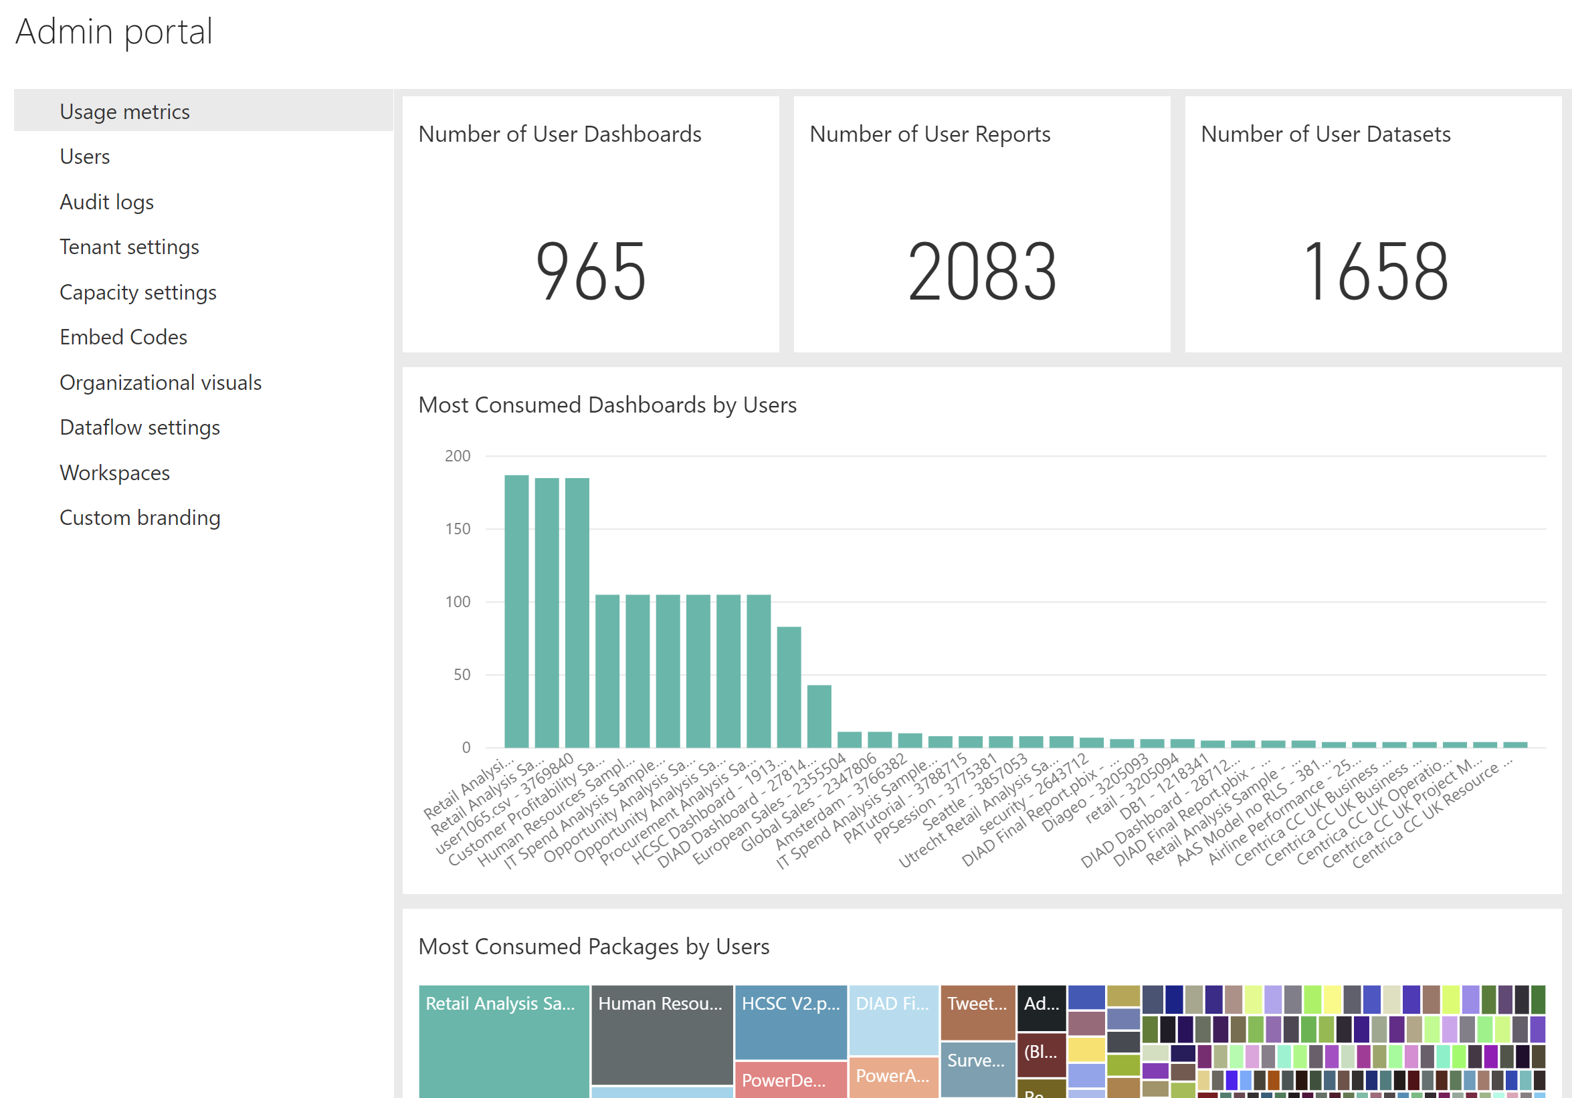
Admin Portal – Usage Metrics
Some of the information on there is useless (eg. “packages”)
Not usage by month, but most active report/dashboard creators
New admin usage metrics are constantly released
© 2022 Microsoft. All rights reserved.

Slide 52
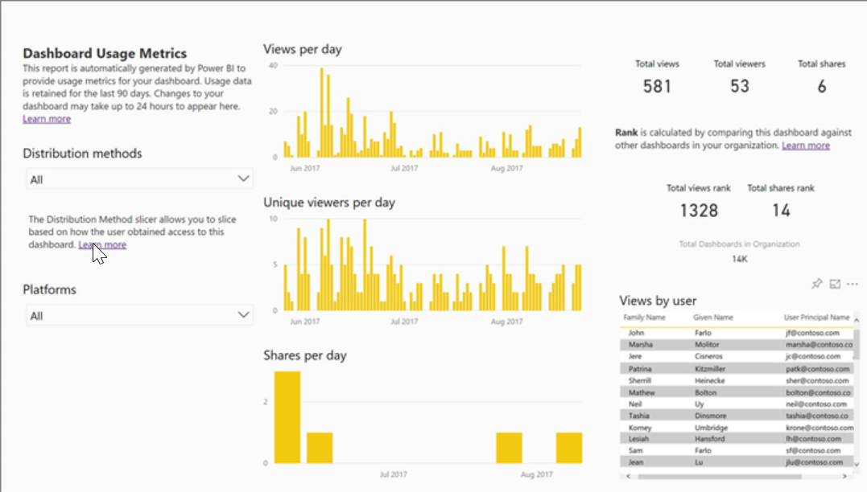
Usage Metrics for Dashboards & Reports
Ability to see usage of individual dashboards and reports
May differ from audit log numbers due to how it is collected
Can create reports with underlying dataset
© 2022 Microsoft. All rights reserved.

Slide 53
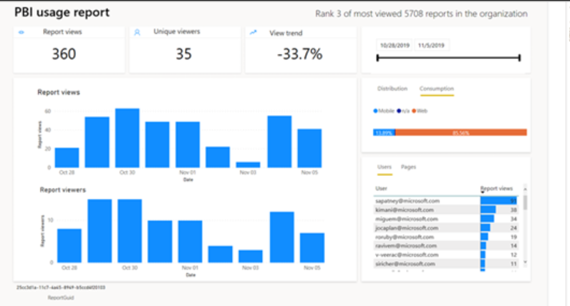
Usage Metrics for Dashboards & Reports – New Version
Will only be available in v2 workspaces
Will contain basic perf numbers for reports
Built on top of a brand-new infrastructure for collecting and storing usage information – more reliable, more scalable, and based on audit events, so no inconsistencies any longer between audit log and usage metrics report
© 2022 Microsoft. All rights reserved.

Slide 54
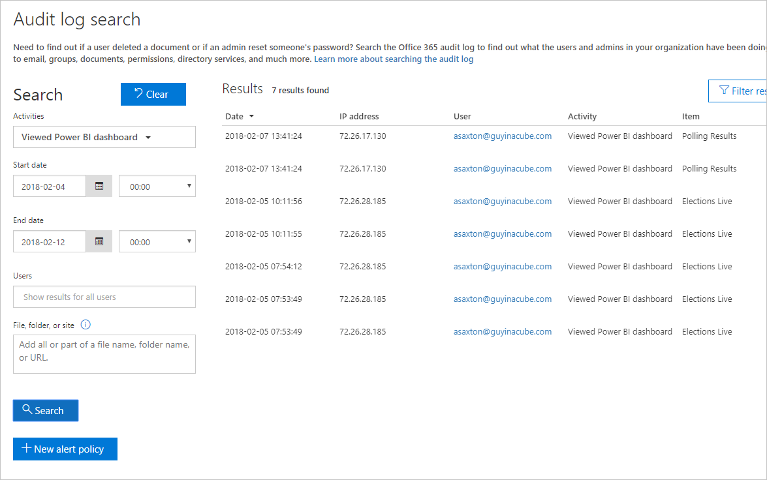
Audit Logs
Requires Exchange Online license
Disabled by default
Can use data to understand usage in Power BI Tenant
Data is retained for 90 days
In-Region Auditing
PowerShell access
© 2022 Microsoft. All rights reserved.

Slide 55
Activity Log
Activity Log is an API that helps Power BI service admins track user and admin activity
There are some key differences between audit log and Power BI activity log
Unified Audit Log | Power BI Activity Log
Includes events from SharePoint Online, Exchange Online, Dynamics 365, and other services in addition to the Power BI auditing events. | Only includes the Power BI auditing events.
Only users with View-Only Audit Logs or Audit Logs permissions have access, such as global admins and auditors. | Global admins and Power BI service admins have access.
Global admins and auditors can search the unified audit log by using Office 365 Security & Compliance Center, the Microsoft 365 Security Center, and the Microsoft 365 Compliance Center. | There’s no user interface to search the activity log yet.
Global admins and auditors can download audit log entries by using Office 365 Management APIs and cmdlets. | Global admins and Power BI service admins can download activity log entries by using a Power BI REST API and management cmdlet.
Keeps audit data for 90 days | Keeps activity data for 30 days (public preview)
Keeps audit data, even if the tenant is moved to a different Azure region. | Doesn't keep activity data when the tenant is moved to a different Azure region
© 2022 Microsoft. All rights reserved.

Slide 56
Power BI Admin in a Day
Demo
Usage Monitoring & Auditing
© 2022 Microsoft. All rights reserved.

Slide 57
Power BI Admin in a Day
Knowledge Check 4 - Usage Monitoring & Auditing ​
https://aka.ms/AdIADReview4​
© 2022 Microsoft. All rights reserved.

Slide 58
Power BI Admin in a Day
Lab 01 - Usage Monitoring & Auditing ​
Download Student Content ​
(Labs file)
https://aka.ms/PBI-AdminIAD ​
© 2022 Microsoft. All rights reserved.

Slide 59
Power BI Admin in a Day
At the end of the training, please fill our survey
https://aka.ms/PBIAdminIADSurvey
It helps us maintain and improve the training
© 2022 Microsoft. All rights reserved.

